Slide 1
Can the mínimum wage reduce poverty and inequality in the developing world? Evidence from Brasil
Orlando J. Sotomayor

Slide 2
Abstract
Even though there is growing social support for higher minimum wages as anti-poverty policy tools, very little is known about their effectiveness in reducing poverty or inequality in the developing world. Latin America’s largest economy offers a fertile setting for shedding light on the issue, in being a large and datarich country where frequent increases in the minimum wage can allow for direct estimation of influence on the distribution of income. Using a difference-in-difference estimator that takes advantage of substantial regional income variation and 21 increases in the Brazilian national wage floor, the study finds that within three months of these minimum wage hikes, poverty and inequality declined by 2.8% and 2.4%, respectively. Influence waned over time, particularly with respect to bottom-sensitive distribution measures, a development that is consistent with resulting job loses that fell more heavily among poorer households. The fact that the following annual hike in the minimum wage led to a renewed decline in poverty and inequality, suggests that potential unemployment costs were again overwhelmed by benefits in the form of higher wages among working individuals. However, evidence also establishes an inelastic relationship between wage floor hikes and changes in the incidence of poverty, as well as diminishing returns to the strategy when the legal minimum is high relative to median earnings.

Slide 3
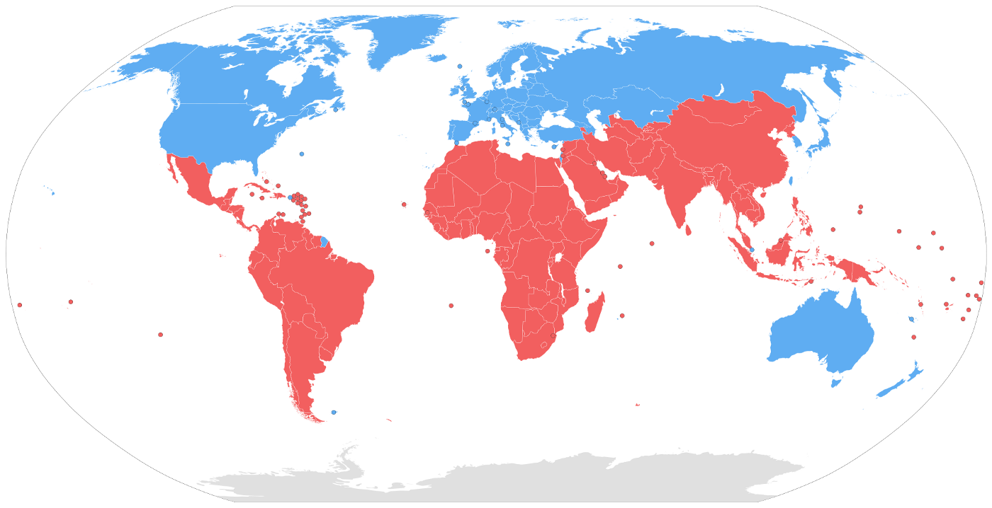
Developed world
A higher minimum wage does not cause meaningful changes in poverty or income inequality, partially as a result of the instrument’s poor target efficiency

Slide 4
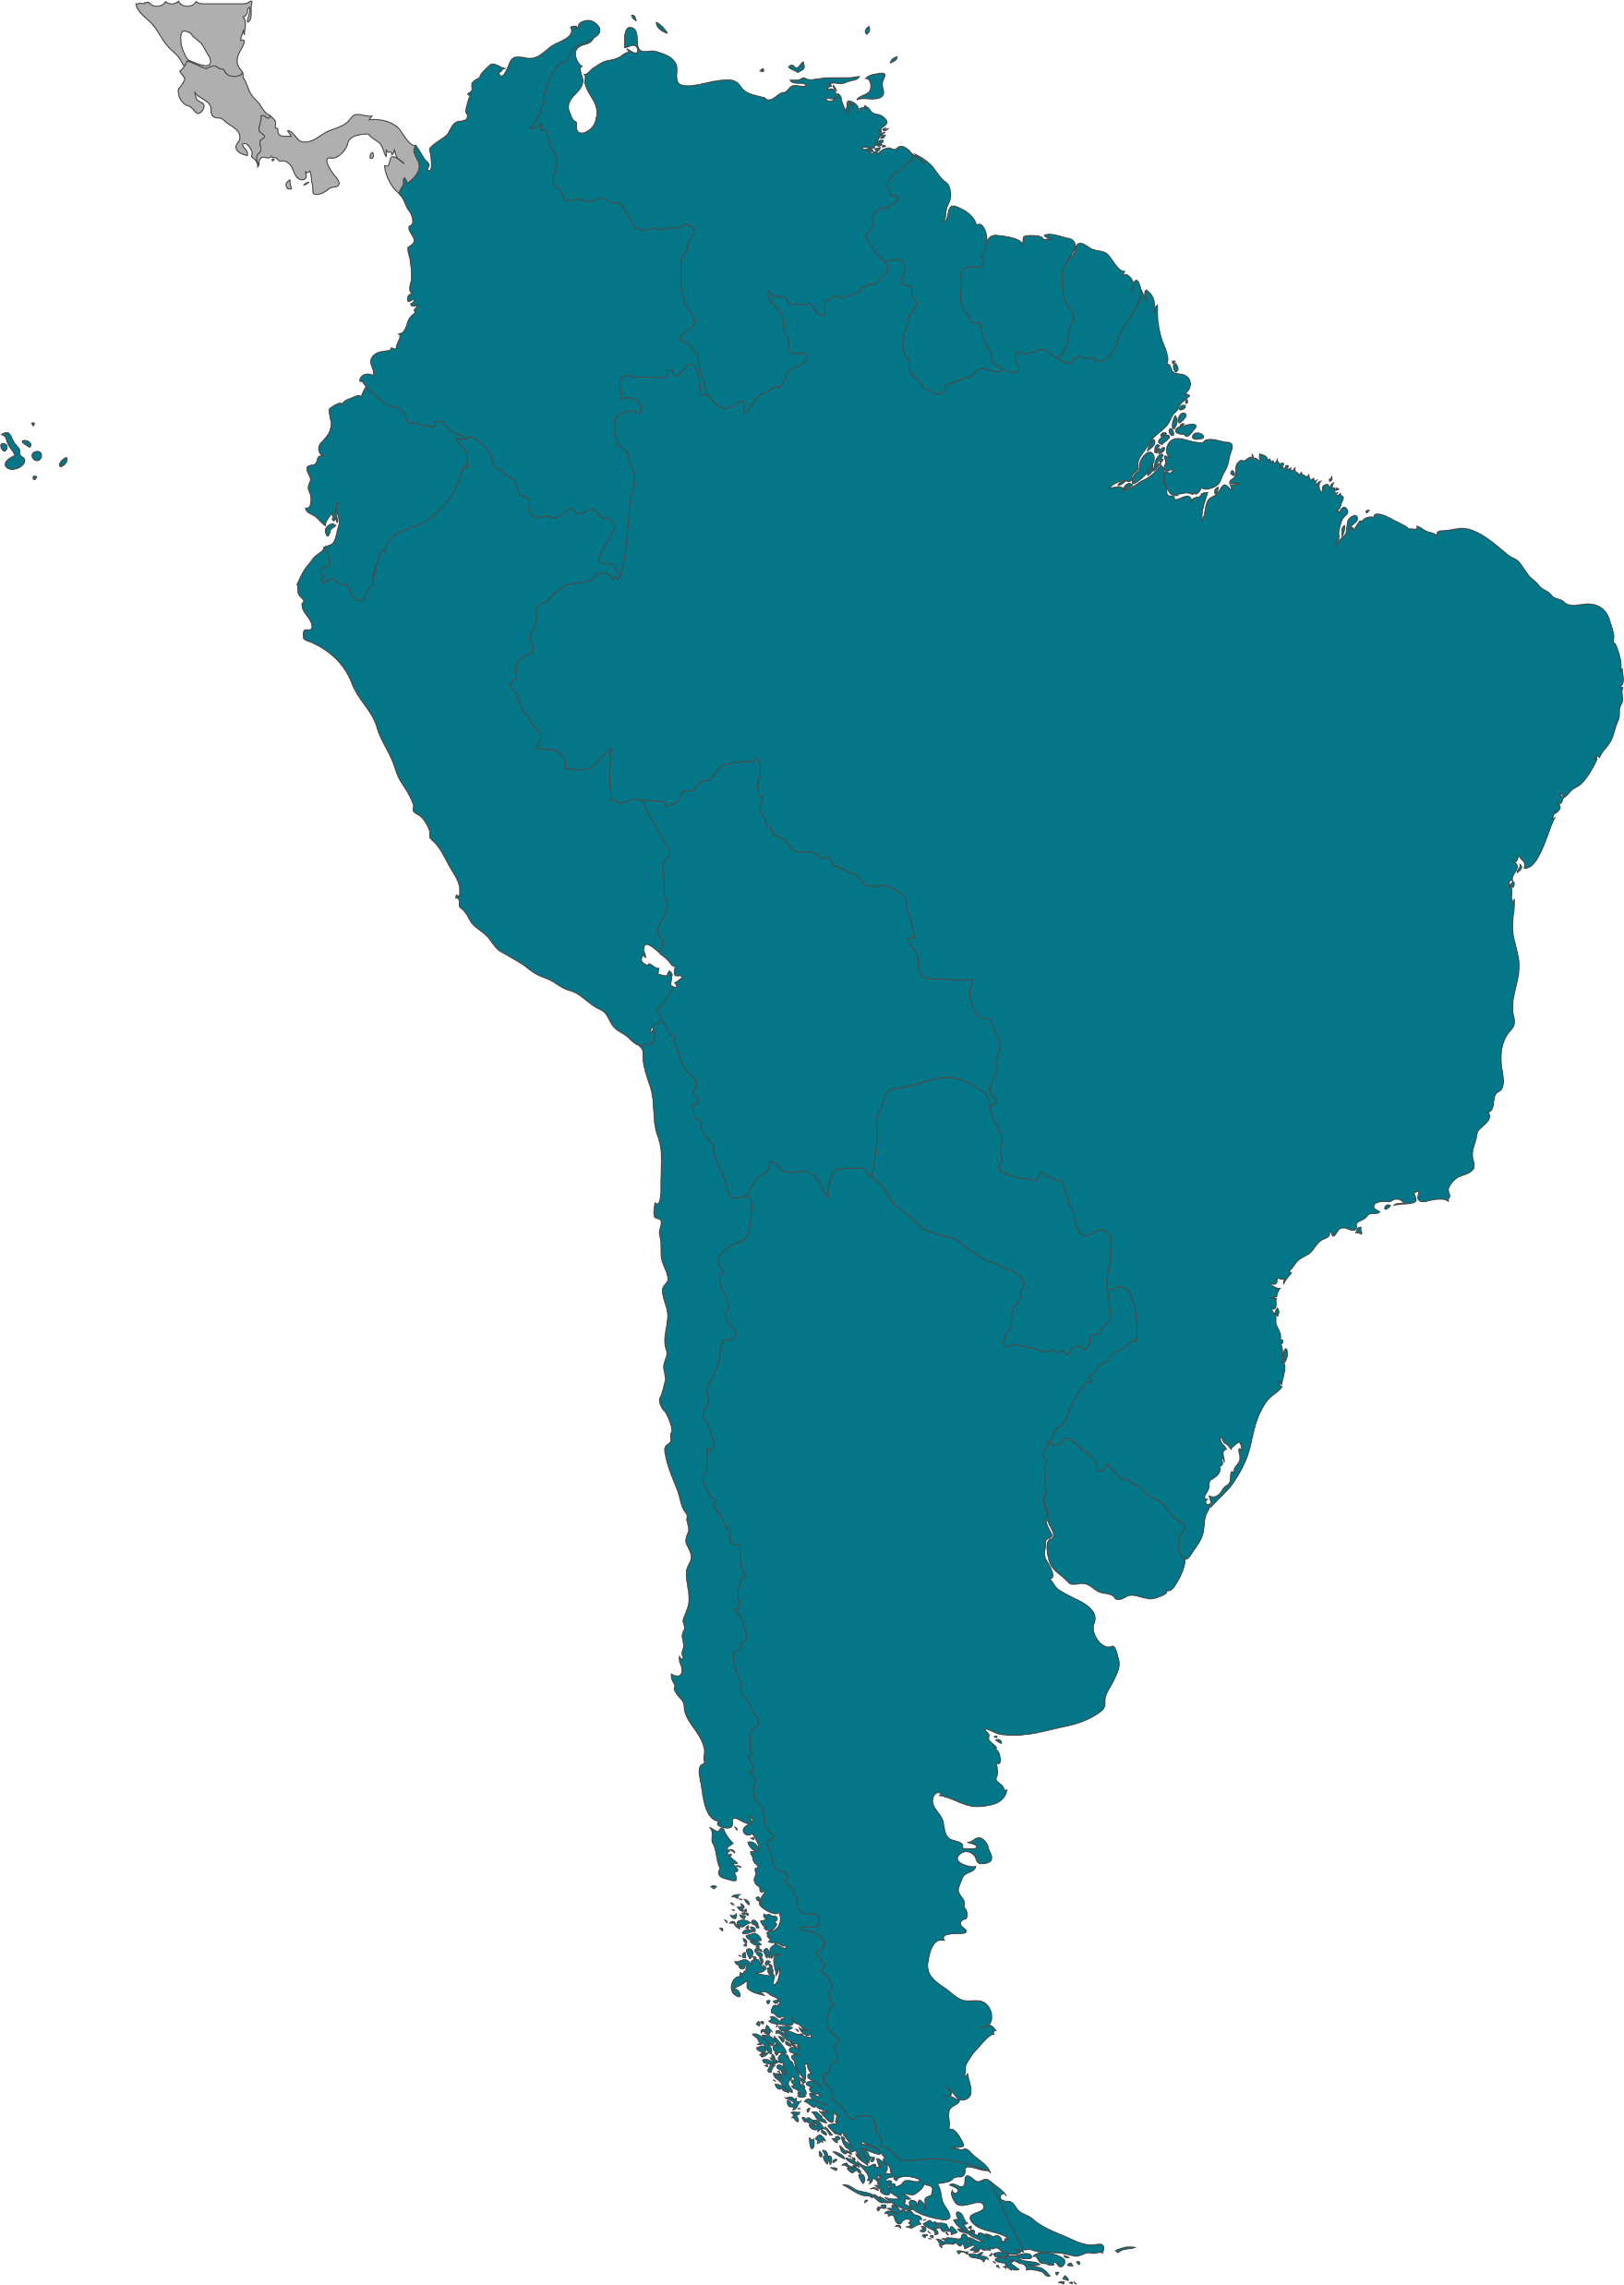
South America
Popular governments have increased minimum wages in the last decades.
Poverty and inequality in the region
Different economic structure

Slide 5
Debate
increases in the minimum wage have little or no effect on employment (Allegretto, Dube, & Reich, 2011; Card, 1992a; Card & Krueger, 1994; Dickens, Riley, & Wilkinson, 2014; Dube, Lester, & Reich, 2010; Hoffman, 2016; Katz & Krueger, 1992)
the wage floor raises unemployment among populations likely to be bounded by it–namely teens and the very low-skilled–and that findings of positive to no effects are generally associated with poor research designs (Neumark, Salas, & Wascher, 2014a; Neumark, Salas, & Wascher, 2014b)

Slide 6
Wage and employment
Studies in Indonesia, Mexico, Trinidad and Tobago, Turkey and other countries shows that mínimum wage hikes generates employment loses in different small sectors and among low-skilled population.
There is other factors that must be studied such as the way the policy is taken, gender gaps, wage levels, firm earnings or job quality.
Bosch & Manacorda (2010).
Alatas and Cameron (2008)
Strobl and Walsh (2003)

Slide 7
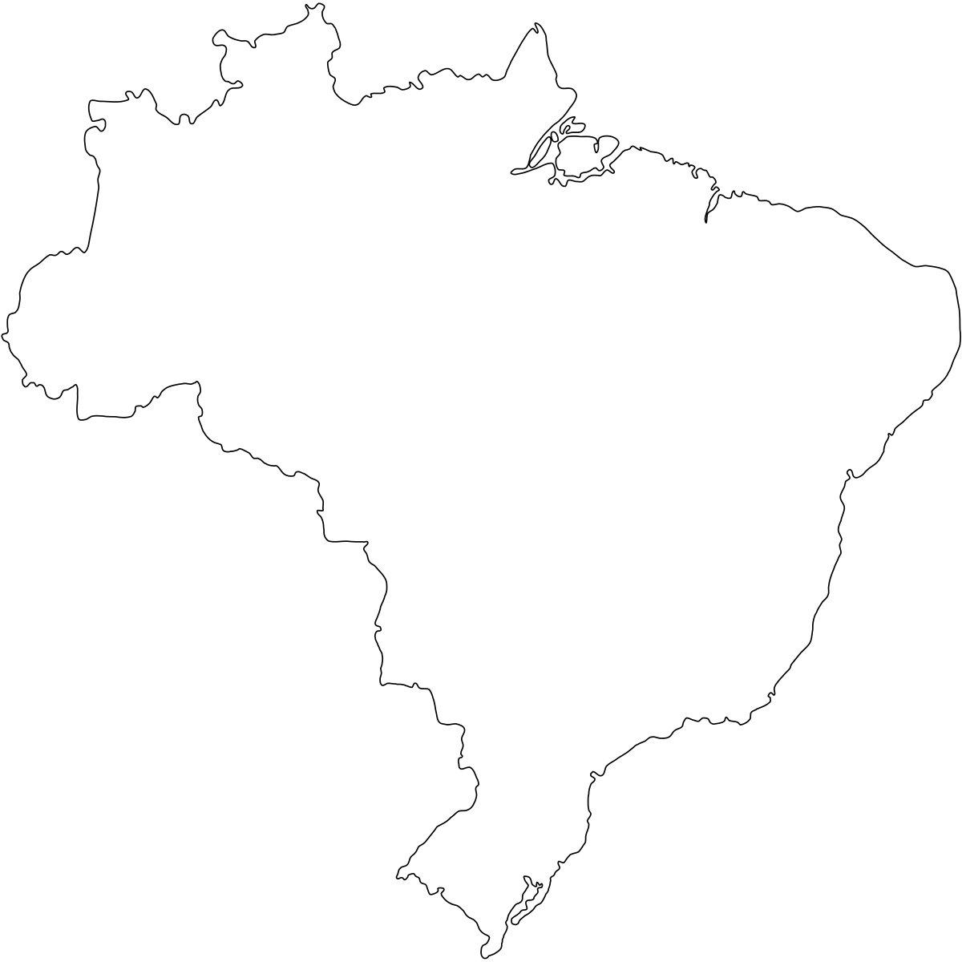
Brasil
Lemos (2004), Lemos (2007), and Lemos (2009) establish that Brazilian minimum wage hikes lead to higher and more equally distributed earnings without loss of employment, even among teenagers and other low-skilled populations
‘’This could be a gap that Brasil and other countries haven’t filled yet ‘’

Slide 9
See: Burkhouser and Finegan (1989), Burkhouser, Couch, and Glenn (1996), Burkhouser and Sabia (2007), Campolieti, Gunderson, and Lee (2012), Card and Krueger (1995), Sabia (2008), Sabia (2014), and Sabia and Burkhauser (2010)

